Slide 1
Your Favorite Book Product Development
Develop a product for a book lover to sell!
Your job is to create the perfect product that goes along with your favorite book.
Channel you inner Pinterest and your creative side!
Choose your favorite book and don’t forget to tell me the name of it.
Use Artemis to find a topic and a quote from or about the book. This can be your inspiration for your product. Include citation!
Create a 2 slide minimum presentation describing your product and how it connects to your book.
Use direct quote from book or review from Artemis.
Provide citation.
Ex. Julius Caesar Knife Block, 1984 Peripheral Glasses, Book visionary app

Slide 2
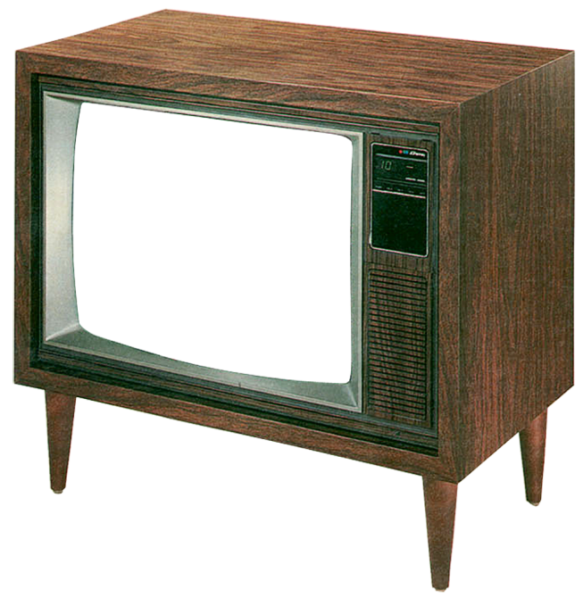
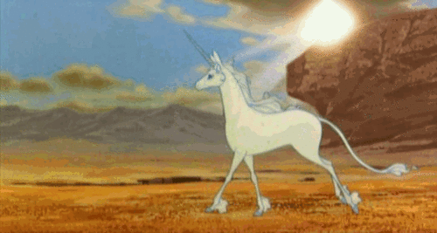
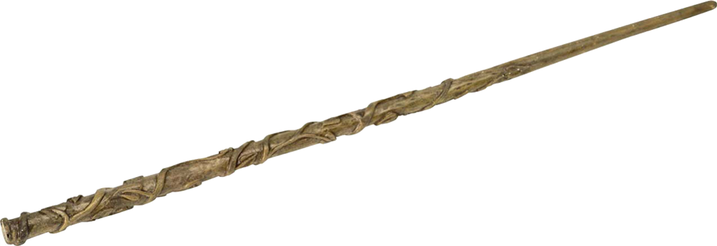
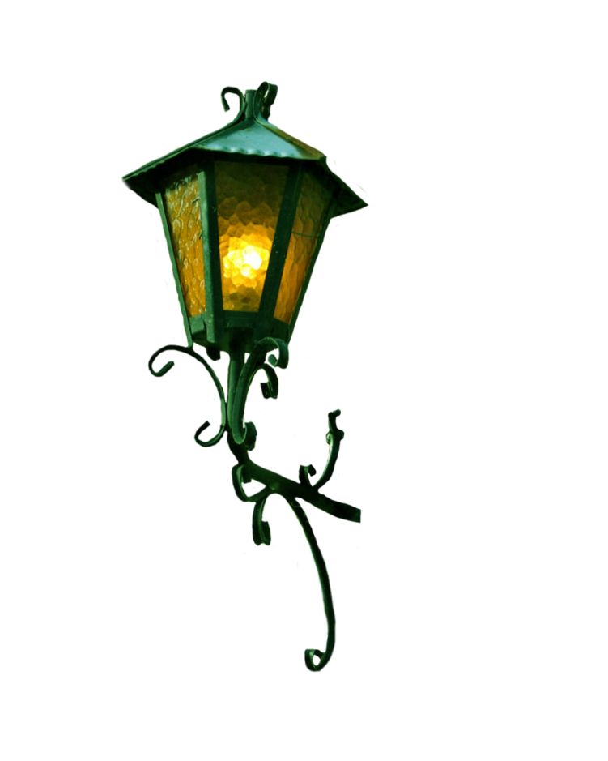
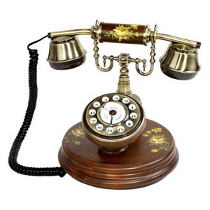
Example 1
Unleash the magic of Harry’s wand!
Turn on the tele!
Turn out the light!
Answer the phone!
Harry Potter’s
Remote Control Wand
is AMAZING!

Slide 3
EXAMPLE 2
Tell me the name of the book!
Describe how your product connects to your book.
Use direct quote from book or review from Artemis.
Provide citation.
Harry Potter and the Deathly Hallows
"It's the wand that chooses the wizard"--an expression that appears, in fact, to be both the first (Rowling [1997] 1999:82, 85) and the last (Rowling 2007:494, 742) proverb used in the series. Although this expression is not exactly metaphorical, the sentiments are apparently also not understood to be mere superstition because, in fact, this "truth" seems to drive the plot in the last volume of the series.
Haas, Heather A. "The Wisdom of Wizards--and Muggles and Squibs: proverb use in the World of Harry Potter." Journal of American Folklore 124.492 (2011): 29+. Literature Resource Center. Web. 29 Apr. 2016.
Connection: The wand is a critical tool for a wizard, and the remote is a common tool for us muggles. By combining the powers of the wand with the remote we can bring magic into our daily lives.
Let this wand choose you!

Slide 4
Rubric
 | 5 | 10 | 15 | 20 | Total
Creativity | Derp | Okay | Neat Idea | Pure Brilliance
Picture | Irrelevant pic | Copied pic/no editing | Thoughtful editing/creation | Supreme editing/creation
Connection | No real connection | Minimal connection | Connection | Deep connection
Quote | No quote | Irrelevant quote | Quote | Awesome quote
Citation | No citation | Really messed up citation | Improper citation | Proper citation
Name/Period | No name or class period | Just class period | Just name | BOTH!
Total

Slide 5
Rubric
 | 5 | 10 | 15 | 20 | Total
Creativity | Derp | Okay | Neat Idea | Pure Brilliance
Picture | Irrelevant pic | Copied pic/no editing | Thoughtful editing/creation | Supreme editing/creation
Connection | No real connection | Minimal connection | Connection | Deep connection
Quote | No quote | Irrelevant quote | Quote | Awesome quote
Citation | No citation | Really messed up citation | Improper citation | Proper citation
Name/Period | No name or class period | Just class period | Just name | BOTH!
Total

